Slide 1
Pidrone Package Orientation
ENGR 430 Computer Vision
Matthew Stein
Roger Williams University

Slide 2

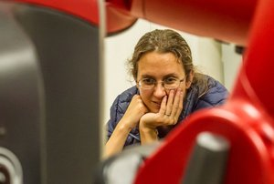
Who thought of it?
Stefanie Tellex @ Brown University
Nishant Kumar graduate teaching assistant

Slide 3
What is it?
A collection of ROS Nodes
A “package” or a “stack”
Mostly employing python scripting language
“Programming language” is more general term, all scripting languages are programming languages
Scripting language does not require a compiling step
Every line could be typed one at a time into a command interpreter

Slide 4
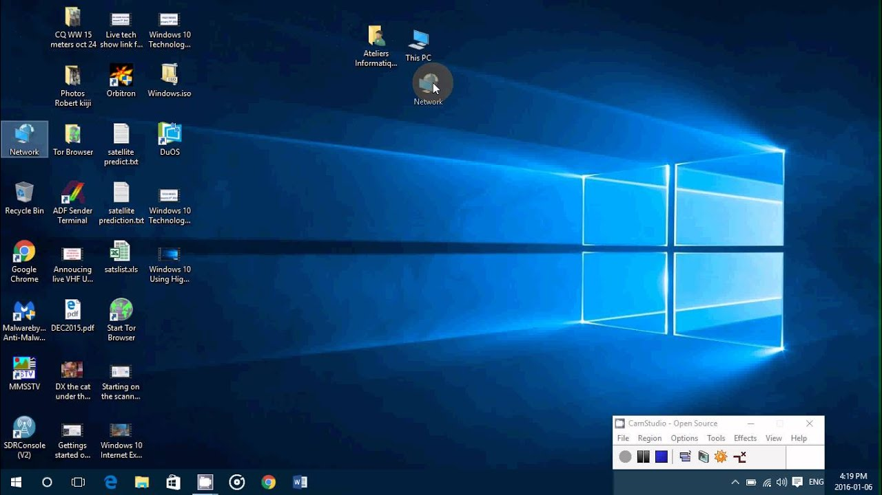

What is an “Operating System”?

Slide 5
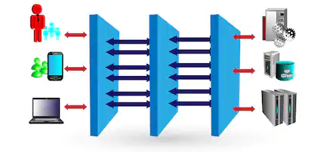
“Middleware”
Applications request:
Run me – give me memory and processor time
Give me access to user (screen, mouse, keyboard, speakers)
Give me access to network

Slide 6
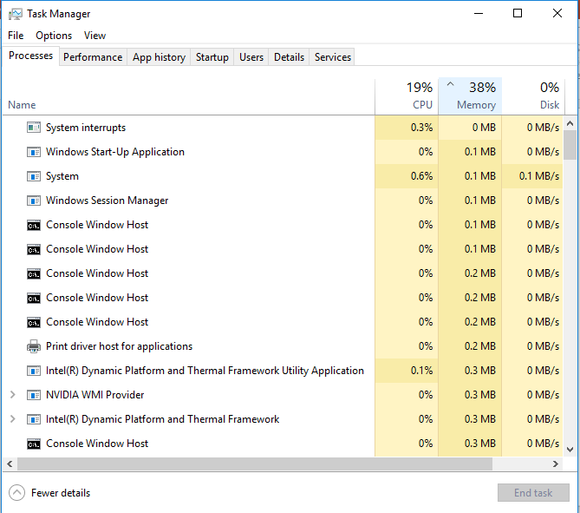

Divide CPU time between simultaneous processes
Present in windows (hidden)
Can get access with CMD

Slide 7
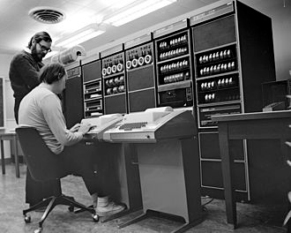
Earliest computers have some form of operating system
Execute Programs
Print results
Manage storage
First platform to run UNIX
Pun on “Multics”
Ken Thompson (sitting) and Dennis Ritchie working together at a PDP-11

Slide 8
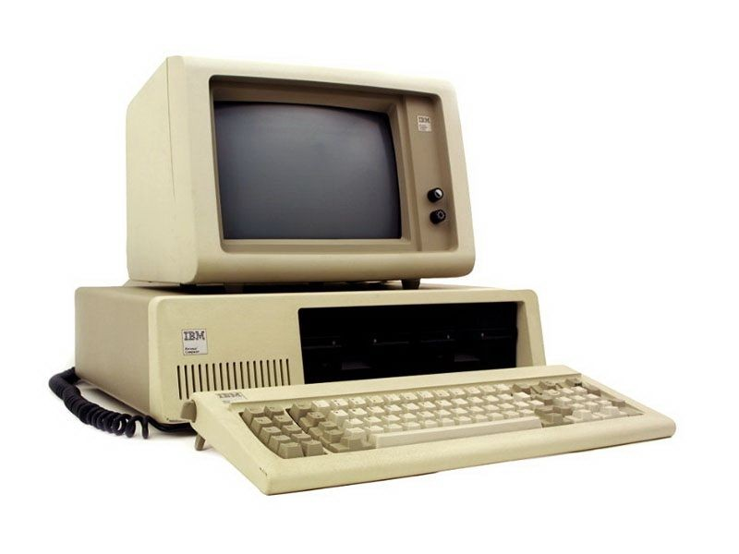
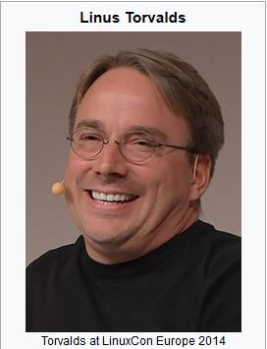
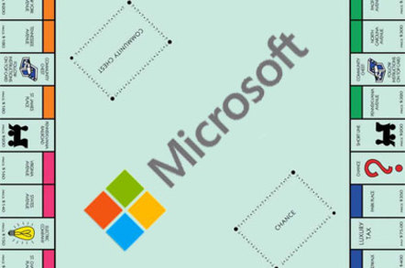
“Linux” operating system
Break the Microsoft monopoly
Linus’ Unix
1991 first prototype, 1994 version 1.0

Slide 9
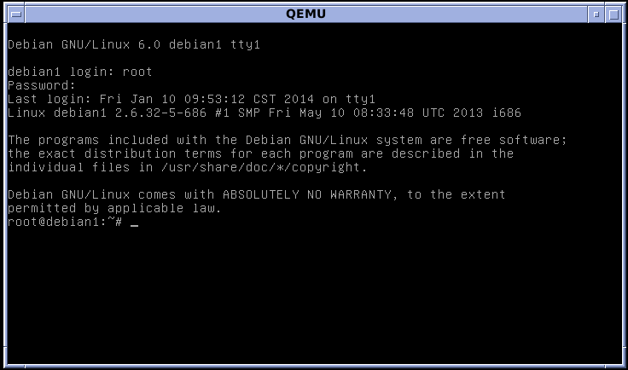
“Command terminal” more visible in Linux
Open up a “shell” and execute the program
Anyone can write a program
Access permissions carefully controlled
Otherwise no limitation on what program can do

Slide 10
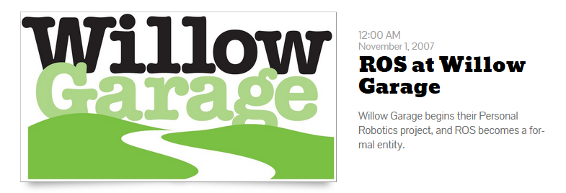
ROS – “Robotic Operating System”
Middleware – no robots actually controlled
Open source – no company sells or maintains it

Slide 11


ROS Primary Features #1
Permits communication between processes
Replaces direct connection with post/follow
De-synchronization essential for “real time” control

Slide 12
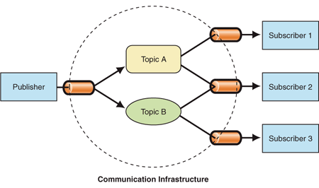
Publisher/Subscriber Model
Any process can be a publish a topic
Any process can be a subscribe to topic
Neither process needs to wait for the other

Slide 13
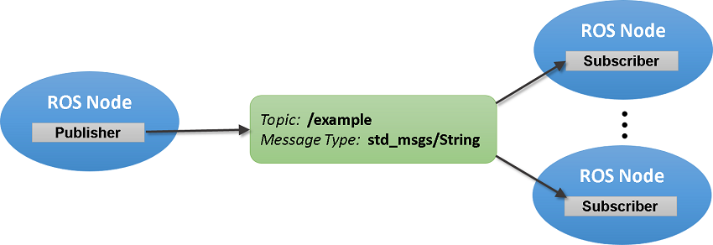
ROS Provides
A common library of messages
A place messages are kept
List of active topics
Service to notify subscribers when a message has been posted
Like What?

Slide 14
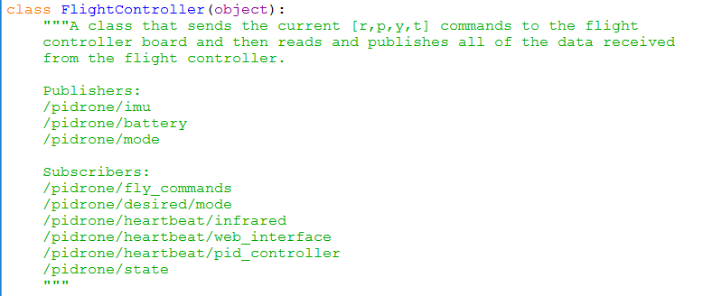
Drone flight requires five simultaneous processes
#1 FC – flight controller
Heartbeat

Slide 15
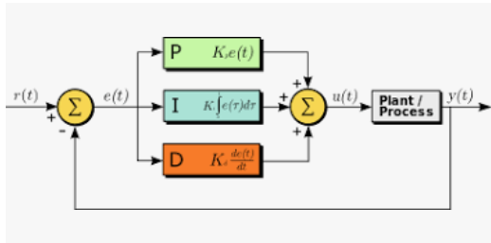
#2 PID Controller
Proportional + Integral + Derivative
Discussed heavily in DMC
Compares “desired” position to state
Applies corrective action to bring the difference to zero
Integral action “gently” applies thrust until desired height is achieved

Slide 16
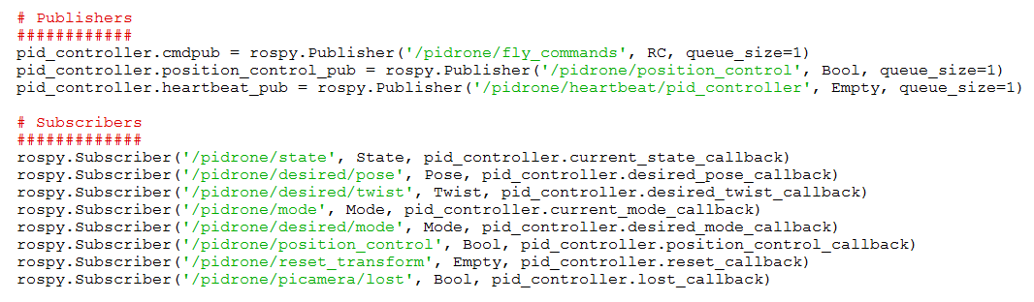
#2 PID Controller
Note queue size
Note message type
Bool – true or false are we in position control
Empty – only content is when it happened, i.e. when did the last heartbeat happen?
RC? What do you think?

Slide 17
#2 PID Controller
Needs state and “desired” pose/twist
Note the use of “callback”
When a message is posted to this topic call this routine. Message itself can be empty.
Twitter?

Slide 18
# 2 PID Controller
When “P” is depressed in the interface the xyz values on the web interface are published to /pidrone/desired/pose
“True” is published to /pidrone/position_control
PID control will attempt to auto-pilot drone to remain at desired position
How we will test vision localization

Slide 19
#3 State Estimator
Only hand-waving this process
How does the drone know its 6D (x,y,z,R,P,Y) position and velocity?
Use “Unscented Kalman Filtering”
Keep the result in “state”

Slide 20
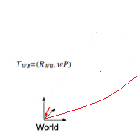
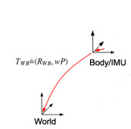
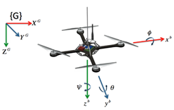
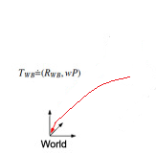
Kalman Filtering?
3 pose estimates
Camera
Altimeter
How to reconcile?

Slide 21
Unscented Kalman Filtering
The qualifier “unscented” differentiates it from “extended”
A way of combining measurements from dissimilar sources to produce the best estimate of the current state

Slide 22

#3 State Estimator
Combine FC Inertial measurement unit, Infrared altimeter and camera estimate

Slide 23
#4 Vision
Publish camera info and images (for web)
Publish pose
Subscribe to reset_transform (R command)

Slide 24
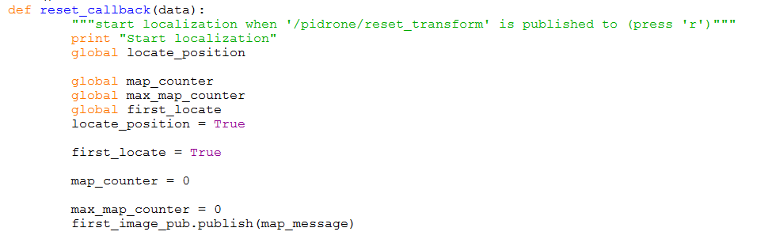
#4 Vision
A look at the “callback” routine
Good practice to make these brief
Set some global variables and publish the map

Slide 25

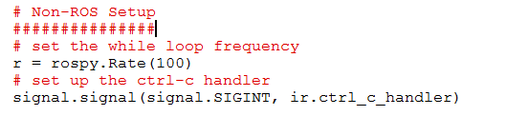
#5 IR
Does not subscribe to anything
Just publishes IR data
Just do this ‘forever’ (until Ctrl-C) at 100Hz

Slide 26
#6 ROS Bridge
Not developed by Brown researchers for this project
Rosbridge provides a JSON (JavaScript Object Notation) API to ROS functionality for non-ROS programs including a WebSocket server for web browsers to interact with. Rosbridge_suite is a meta-package containing rosbridge, various front end packages for rosbridge like a WebSocket package, and helper packages.
Allows control station to interact with ROS through web browser

Slide 27
#7 web_video_server
Also not developed by Brown researchers for this project
Allows video images to be viewed by remote control station
Optional

Slide 28
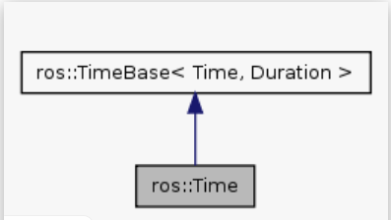
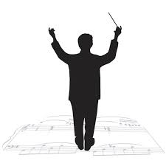
ROS Primary Features #2
Provides a global sense of time
Messages are not synchronized but often still need to know if they are stale
Not exactly when but which happened first?

Slide 29


ROS Primary Features #3
Real time ROS Nodes
ROS controls their execution, activate, suspend, kill, etc.
Can specify Rate that the process runs
ROS runs the node at that rate
Otherwise run it as often as
possible

Slide 30
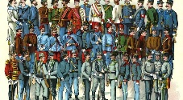
ROS Primary Features #4
Accommodates diversity
Some shells ROS nodes some are just python scripts
Some written in Python some in C
Some are just installed from public “git” sites
All is open source, one could change ROS itself to suits one’s purpose

Slide 31
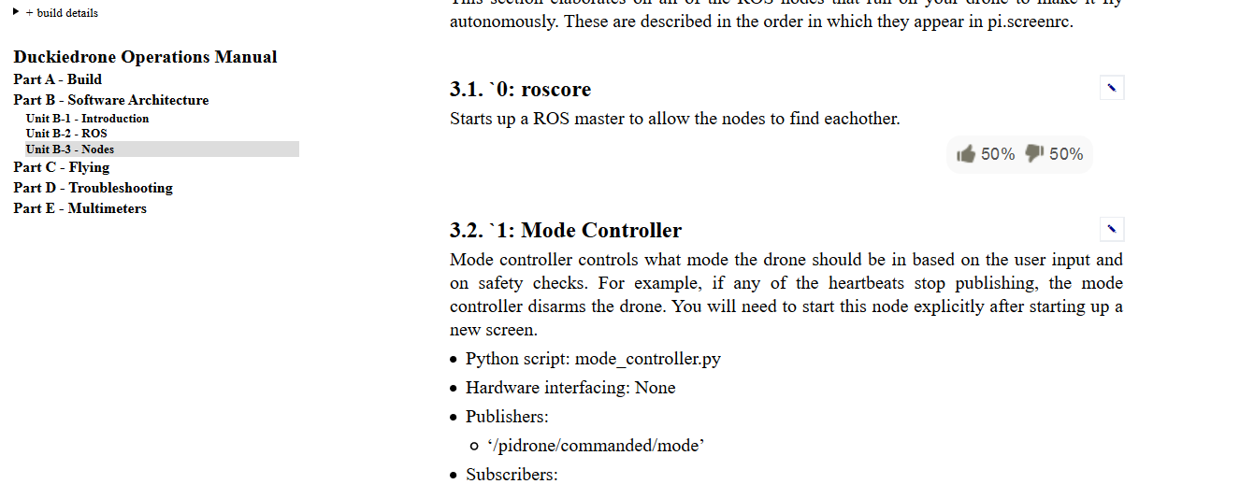
Instruction site a little stale

Slide 32
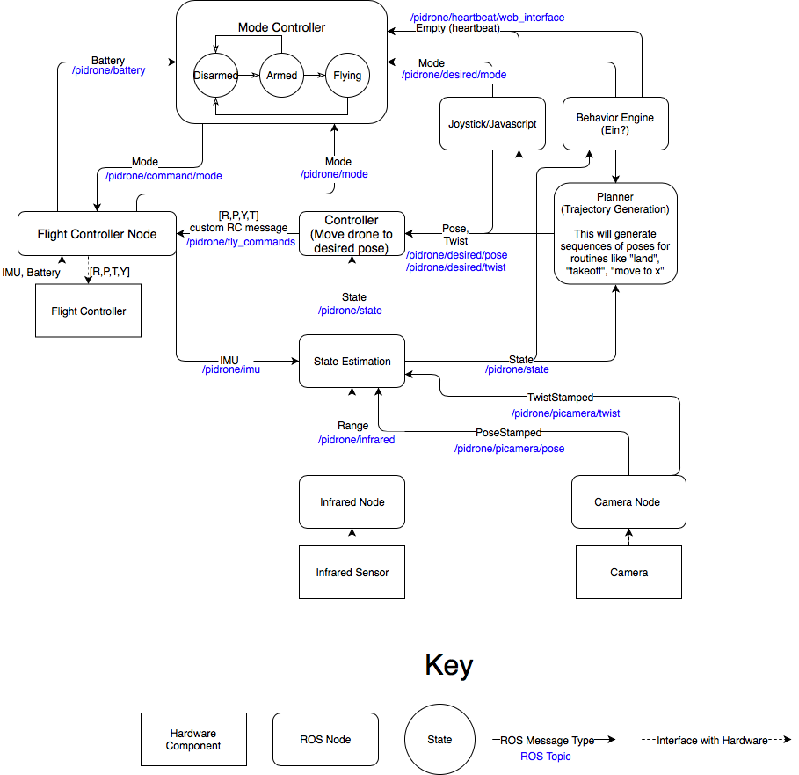
Bubub…bub…bubbbuub

Slide 33
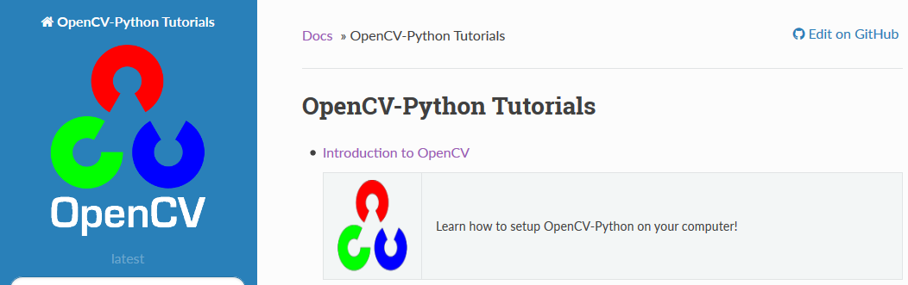
Single_map_localization
Main function is familiar: ORB, knnMatch, estimateRigidTransform
Examine some of the ROS infrastructure in this context
cvBridge – package to calls CV in ROS programs

Slide 34
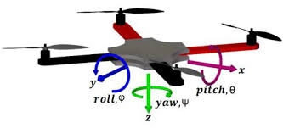
Returning Pose
6DOF Drone in Free Flight
Reduce to 3DOF x, y, yaw, make no attempt at z, pitch roll

Slide 35
Returning Pose
Roll and pitch hard to get reliably from camera
Rely entirely on IR altimeter for Z

Slide 36
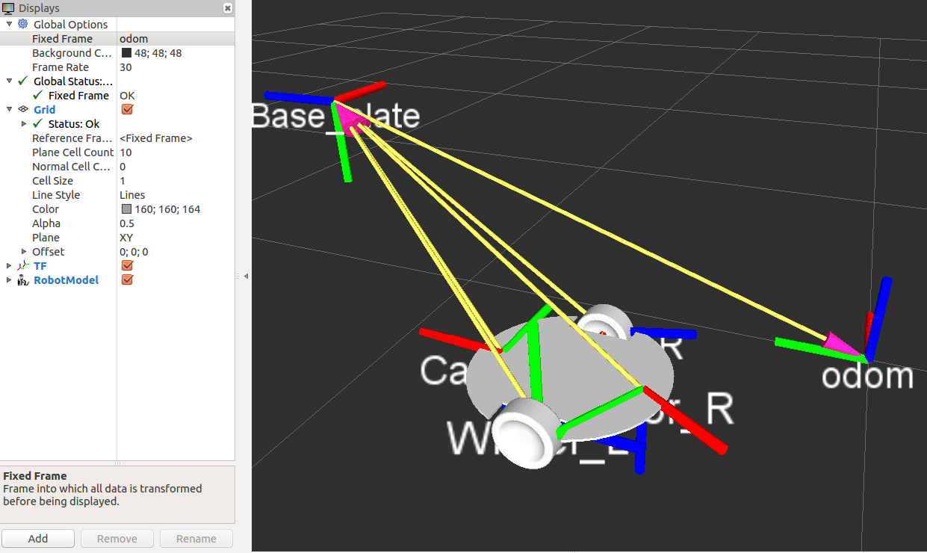
ROS Transform
Specify 6 DOF position/orientation of a frame relative to another

Slide 37
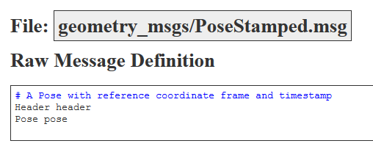
‘pose’ published to other nodes as a PoseStamped
posemsg = PoseStamped()
Header a time stamp
stamp = rospy.Time.now()

Slide 38
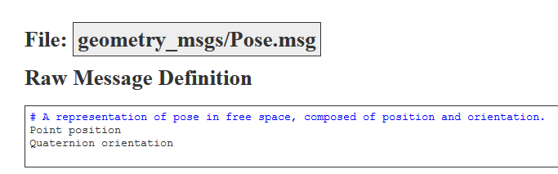
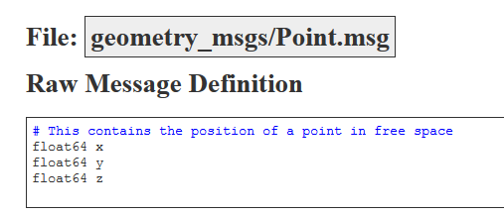
Pose is a position and orientation
Point and quaternion
Point is easy to understand

Slide 39
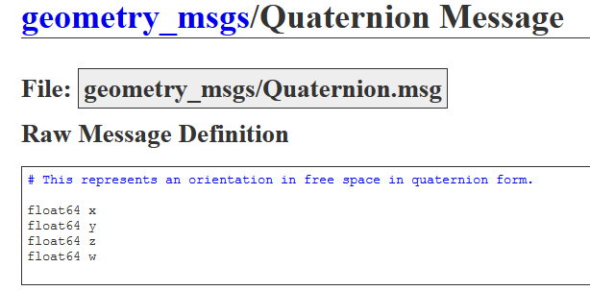
Quaternion less so…
The trouble with RPY
https://www.allaboutcircuits.com/technical-articles/dont-get-lost-in-deep-space-understanding-quaternions/

Slide 40
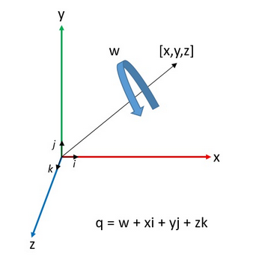
Quaternion
Expressed as an axis (x,y,z) and rotation about that axis

Slide 41
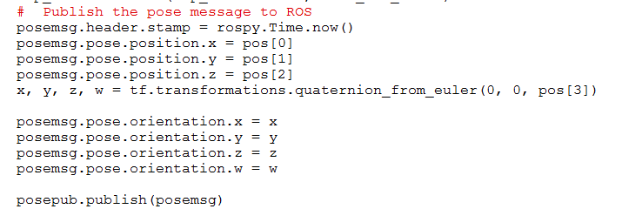
Make some sense of this

Slide 42

Also note some attempt at filtering
Weighted average of new and current position, new position averages into current smoothly or abruptly depending on hybrid_alpha
Look at single_map_localization now….

